Slide 1


AMAZON PRODUCT REVIEW ANALYSIS
Negative sentiment forecasting
Strawberry trend forecasting
Positive sentiment forecasting
Comparison of datasets
Negative sentiment forecasting
Krups Grinder trend forecasting
Positive sentiment forecasting
Forecasting methodology
Product name recognition
Thank you
Suggestions
Presented by:
Jeevan
Sourav
Creysac Florance
Apthi Suvarna

Slide 2

Glimpse of Data
The dataset contains the following columns:
1. Reviewer ID : Unique ID of each reviewing customer
2. Asin : Product ID for different products
3. Reviewer Name : Names of reviewers
4. Helpful : Count of helpful reviews out of total reviews
5. Review Text : Reviewer opinion regarding the product
6. Overall : Ratings for the product given by reviewer
7. Summary : Brief statement of the Review Text
8. Unix Review Time : Time stamp representing the no, of seconds since
1 January 1970 to the time when review is given
9. Review Time : Time of review

Slide 3

Business Objectives
To classify the reviews into particular categories based on different sentiments
To find out the product names with most number of negative and positive reviews so that we can understand why the product is positively or negatively reviewed.
To study how the customer sentiments towards the product are changing with time and to forecast
the future of sentiments trends.
To understand the trends of products which are most positively and
negatively reviewed.
To compare given pair of datasets for future analysis.
3

Slide 4
EDA visualization through Tableau

Slide 5
Data Cleaning
Tokenization
&
Data Vectorization
Sentiment Intensity Analyzer
Review categorization
Work flow of Review categorization
Cleaning the data for further analysis
Converting the words into numbers
Calculating sentiment scores
Based on the sentiment score
5

Slide 6
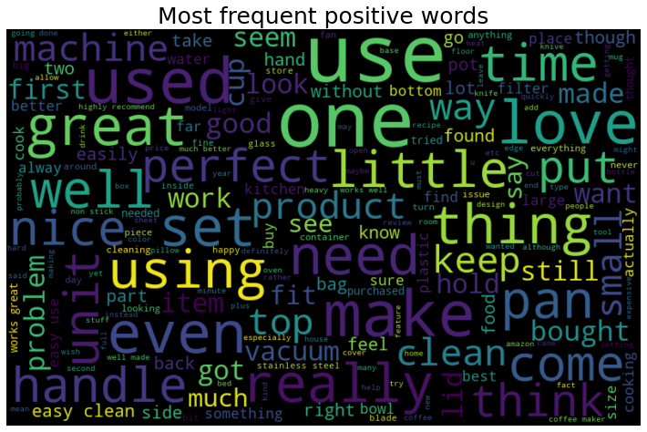
Word cloud of positive sentiment
Positive words
Great
Perfect
Nice
Well
Easy
Love
Best
Clean
6

Slide 7
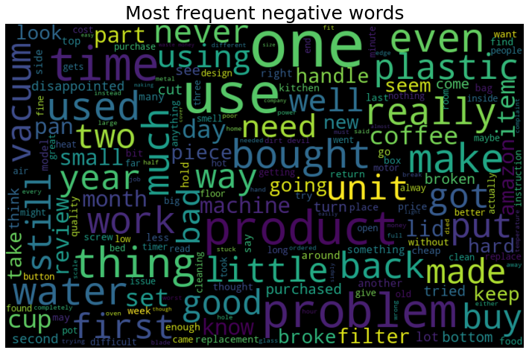
Word cloud of negative sentiment
Negative words
Problem
Broke
Small
Never
Hard
Replacement
Issue
Difficult
Word cloud of positive sentimnt

Slide 8
Analysis of reviews
Input Text | Decisive Words from the text | Sentiment Scores | Sentiment (Output)
This mix makes great pancakes, drop biscuits, and pumpkin bread! I have also used it to make a long-time family favourite - Jewish Apple Cake! I used it cup for cup and left out the baking powder. Incredible!! | Incredible, favourite, great | 0.9545 | Excellent
These do ok for managing my hunger, through the morning, but they are quite dry, and had me wanting water, or something to drink after. These are very fragrant, with an apple smell. | fragrant | 0.6997 | Good
When I don't want to use chipotle con adobo from a can, this is my fallback. It seems to lack a little punch and some of the smoky flavour of the canned versions, but it is a fair replacement | _ _ _ _ _ | 0 | Average
Never had caviar before... Shouldn't have started with cheap stuff but hate to buy expensive and possibly not like it | cheap, hate, expensive | -0.2006 | Bad
Does not mix well at all, lots of nasty sediment at bottom of cup. Bitter and burnt tasting as with most Starbucks coffees. Not buying ever again. | Bitter, nasty, burnt | -0.9719 | Worst
8

Slide 9
Count of different sentiments
Home & Kitchen
Sentiment | Count of reviews
Excellent | 53502
Good | 8972
Average | 3934
Bad | 2357
Worst | 1235
Grocery & Gourmet food
Sentiment | Count of reviews
Excellent | 49981
Good | 5720
Average | 2333
Bad | 1318
Worst | 648
9

Slide 10
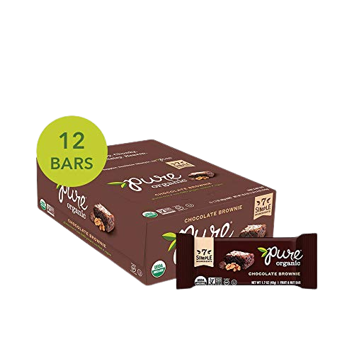
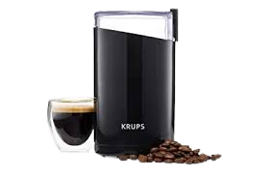
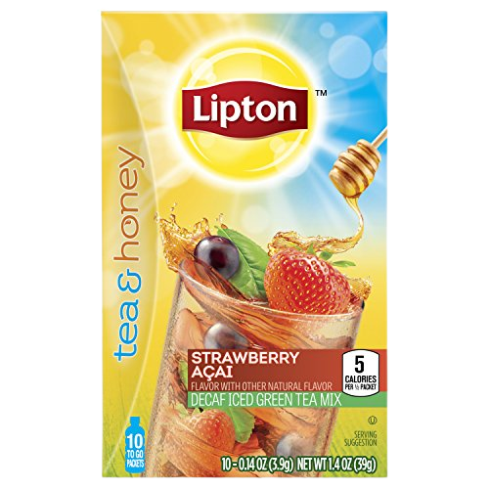
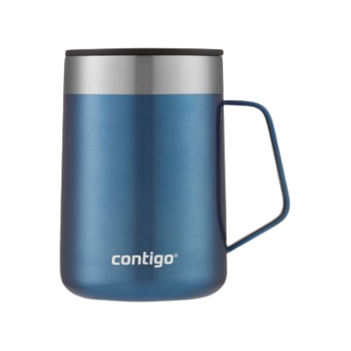
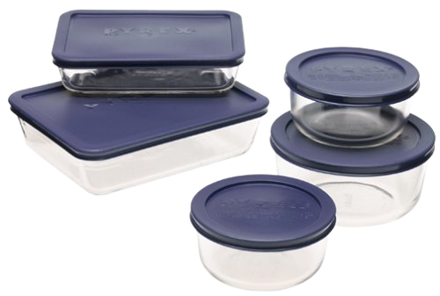
Product name recognition
We are using Named Entity Recognition method to find the product names.
Product ID (Input) | Review text (Input) | Product Name (Output)
B00004SPEU | Krups had good reviews when I bought my first grinder over 10 years ago. That first one is still working perfectly but now I have three. | Krups Grinder
B000FEH8ME | Most unpleasant. The taste isn't bad, but it ain't a chocolate brownie | Chocolate Brownie
B000QFDNP8 | I've had my Contigo coffee tumbler for less than a week, but this is a winner. | Contigo Coffee Mug
B007B9WAH4 | I was very excited to try Lipton Tea and Honey To Go Packets after I read "sweetened with honey" on the packaging | Strawberry Lipton Tea
B00005B8K5 | So these are glass bowls - great for not ingesting any more chemicals than necessary. | Glass bowls
10

Slide 11


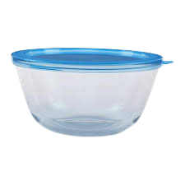


Comparison of prices
Krups Grinder
Contigo Coffee Mug
Glass bowls
Brand: Krups
Price: $22.45
Brand: Contigo
Price: $22.48
Brand: Pure Bar
Price: $17.5
Chocolate Brownie
Strawberry Lipton Tea
Brand: Pure Bar
Price: $23.5
Brand: Lipton
Price: $7.95

Slide 12
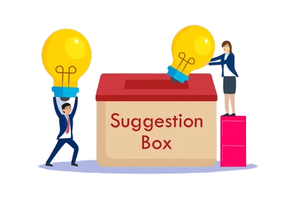
Suggestions
Products with most positive reviews:
Krups Grinder, Glass bowls and Chocolate Brownie are three of the best products. These products have most number of positive reviews
These products can be recommended for more customers
Products with most negative reviews:
Contigo Coffee Mug and strawberry Lipton Tea are two of the products
received most number of negative reviews
These products require evaluation before getting delivered to customers
12

Slide 13
Reasons for negative reviews
Product name | Input text | Reason for negative review
Contigo Coffee Mug | I purchased this for my husband for Christmas and he said that the lid has a terrible taste to it and will not drink from it. For some reason, after using this Contigo tumbler for less than 2 months, it suddenly became a dribble glass. | terrible taste leak
Strawberry Lipton Tea | All you can taste is artificial sweetener. It is inconceivable how they can describe this product as "sweetened with honey." I can't taste any fruit either. This stuff is horrid! | artificial sweeteners horrid
13

Slide 14
EDA visualization through Tableau

Slide 15
Work flow of Sentiment forecasting
1
Resample the data monthly
2
Check for trend and seasonality
3
Build multiple models
4
5
Select the best model
Forecast the trend

Slide 16
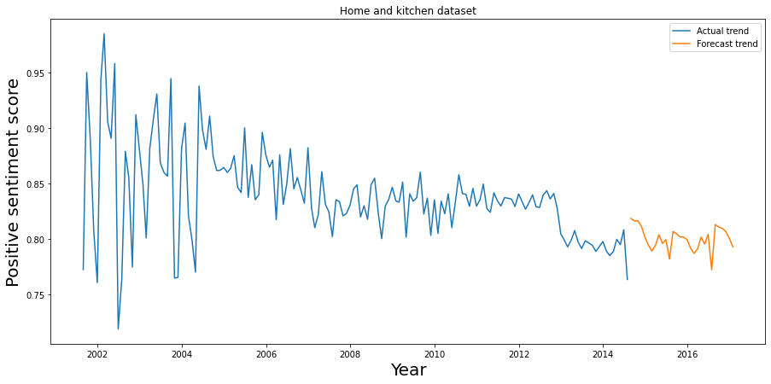
Positive sentiment forecasting
16

Slide 17
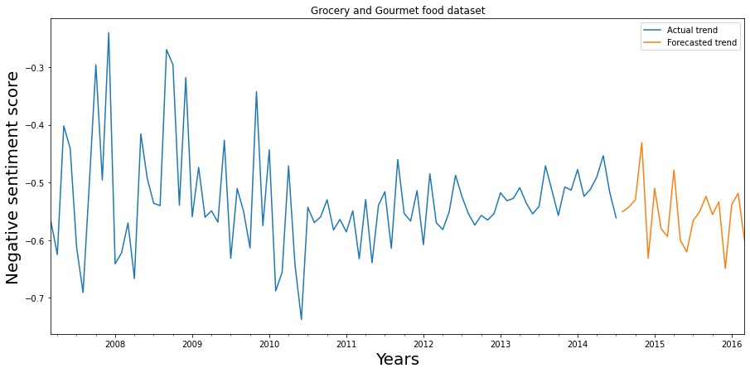
Negative sentiment forecasting
17

Slide 18
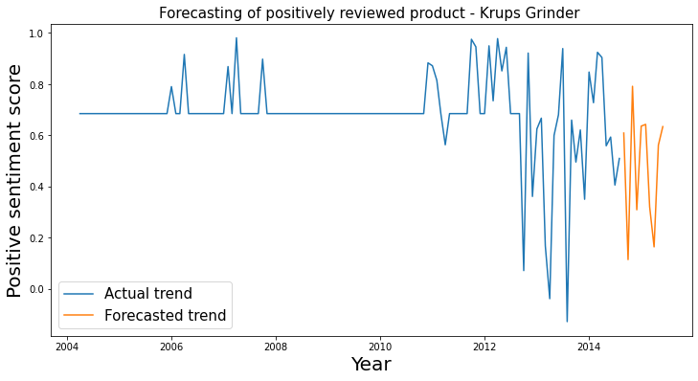
Forecasting positively reviewed product
18

Slide 19
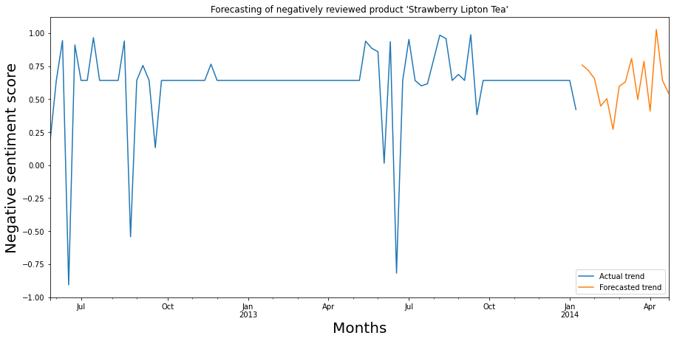
Forecasting negatively reviewed product
19

Slide 20
Comparison of datasets
The forecasted trends for negative reviews are consistent
The forecasted trends for positive reviews are in decreasing manner
Joanna Daneman, Comdet, Chandler and Mike Tarrani "Jazz Drummer”
are some of the common reviewers
Home & Kitchen
Grocery
&
Gourmet Food
1278 reviewers
Mean price of products :
$ 44.6
Mean price of products :
$ 23.3
Most number of positive reviews
Most active reviewer
Mike
Most active reviewer
C Hill
20

Slide 21
Comparison of datasets
Bobs Red Mill
Home & Kitchen
Is the most liked brand with 1151 positive reviews
OXO
Is the most liked brand with 2371 positive reviews
Nutiva
Is the most disliked brand with 14 negative reviews
Cuisinart
Grocery & Gourmet Food
Is the most disliked brand with 92 negative reviews
21

Slide 22

Product recommendation system
A product recommendation is basically a filtering system that seeks to predict and show the items that a user would like to purchase.
Based on the customer’s search and purchase, it will recommend
few other products which other customers also brought.
The recommendation system provides ‘frequently bought together’
option to help customers buy the combo.
Based on the items in their shopping cart or the items which they have
viewed, it will suggest the products.
22

Slide 23
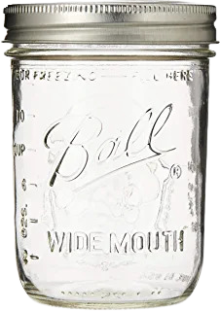
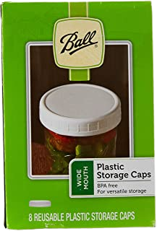
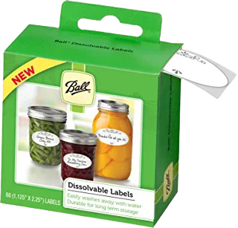
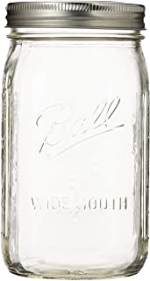
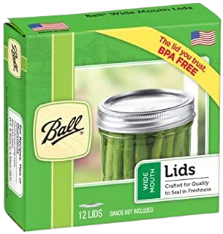
Product recommendation system
Product ID | Recommended products
B001DIZ1NO (Ball Mason "PINT" Jars ) | B000SSN3L2 (Ball Wide-Mouth Plastic Storage Caps) B00B80TLOM (Ball Qt Mason Jar ) B004NGVIIK (Ball Dissolvable Labels ) B000PSCBZO (Ball Jars Wide Mouth Lids )
23
B001DIZ1NO
B000SSN3L2
B00B80TLOM
B004NGVIIK
B000PSCBZO

Slide 24

Conclusion
After observing the sentiments of reviews, we found that most of the reviews are of positive sentiments.
Over the time customers’ expectations have increased which results in reduced positive reviews.
Even though the price of positively reviewed products is not
low as compared to the negatively reviewed products, customers
liked them because of the quality.
The products of same brand or similar products are recommended
by the product recommendation system.
24

Slide 25
O
T
N
Y
A
U
K
H

